Slide 1
MODULE 1

Slide 2
Introduction to Renewable Energy Sources
Course Objectives
To understand energy scenario, energy sources and their utilisation, renewable energy tecchnologies and conversion, presend needs and future demands of society, energy conservation.

Slide 3
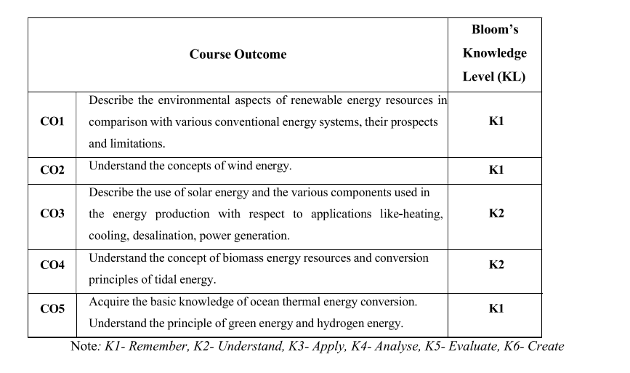

Slide 4
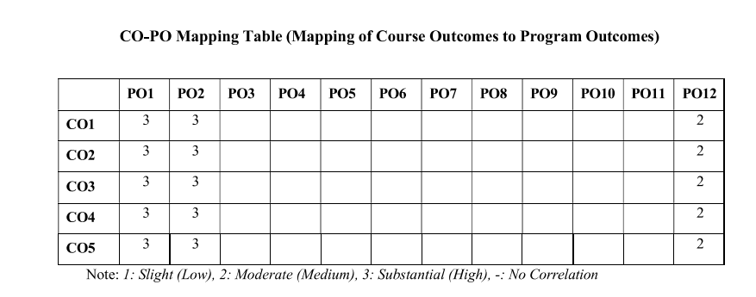

Slide 5
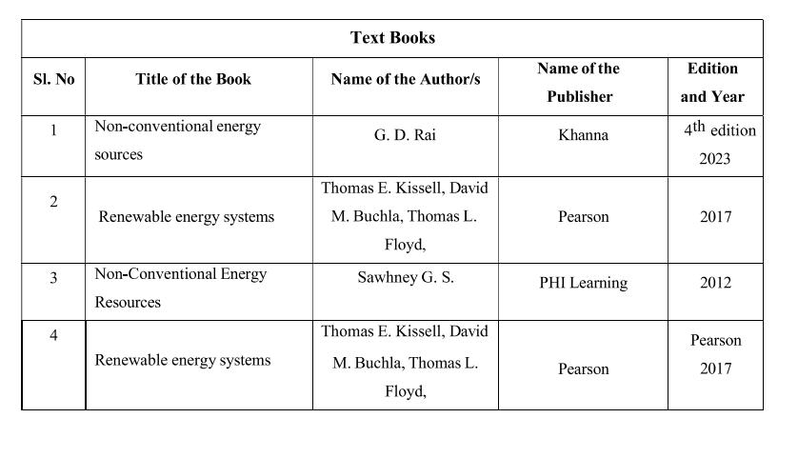

Slide 6
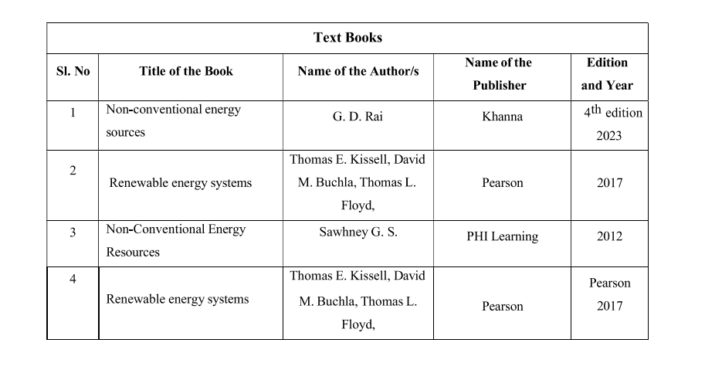

Slide 7


Slide 8
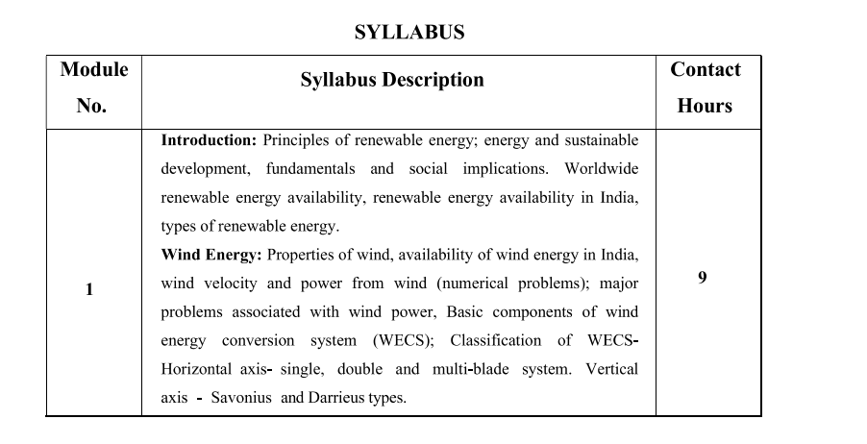

Slide 9
ENERGY RESOURCE
An energy resource is something that can produce heat, power life, move objects, or produce electricity.
Matter that stores energy is called a fuel.
Energy resources are all forms of fuels used in the modern world, either for heating, generation of electrical energy, or for other forms of energy conversion processes.
Energy resources can be roughly classified in three categories: fossil, nuclear and renewable.

Slide 10
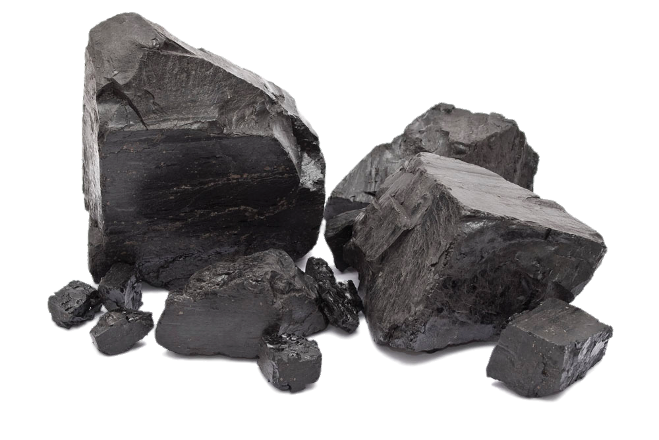
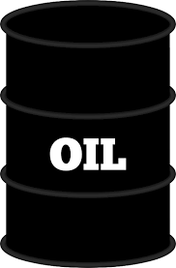
Classification of Energy Resources
1. Based on Usability of Energy
a) Primary Resources
    Energy extracted or captured directly from natural resources
    Example: Coal, Oil, Gas, etc.
b) Secondary Resources
Transformed from primary resources
Example: Steam, Electricity, etc.

Slide 11

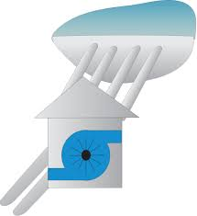


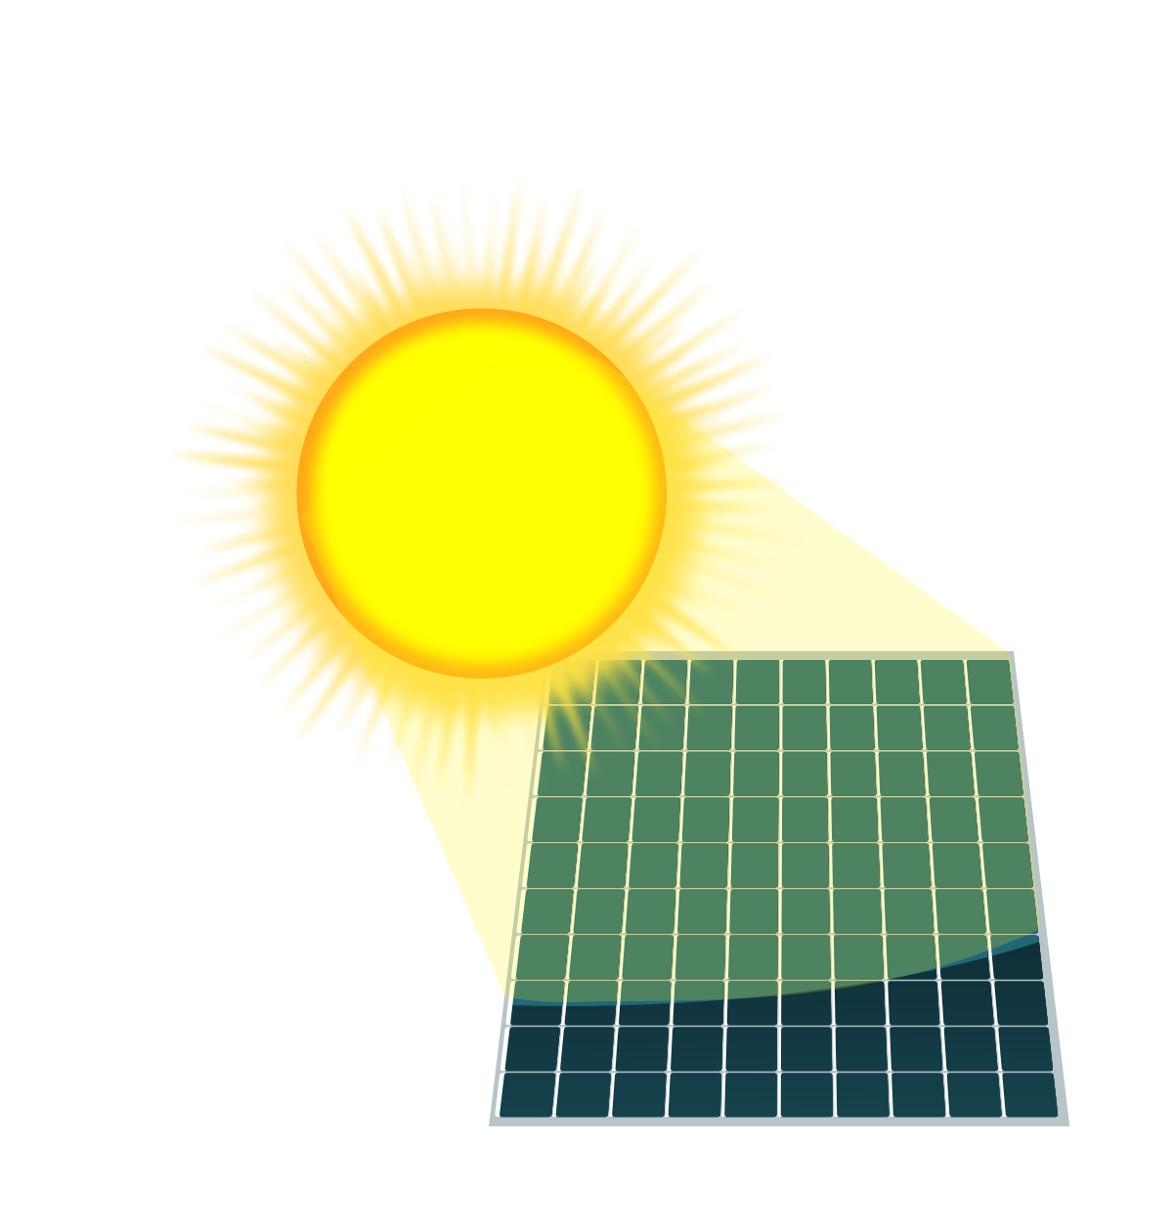
Classification of Energy Resources
2. Based on Traditional Use
a) Conventional
    Being traditionally used since decades
    Example: Fossil fuels, nuclear, hydro etc.
b) Non-conventional
Large-scale use after oil crisis (1973)
Example: Solar, Wind, etc.

Slide 12
Classification of Energy Resources
3. Based on Long-Term Availability
a) Non-renewable
    Finite natural resources
    Does not get replenished at the rate of consumption
    Example: Fossil fuels, Uranium, etc.
b) Renewable
Obtained from natural resources
Essentially inexhaustible
Example: Wind power, Solar power, etc.

Slide 13
Classification of Energy Resources
4. Based on Commercial Application
a) Commercial Energy
    Available in the market for a definite price
    Example: Electricity, Diesel, etc.
b) Non-commercial Energy
Not available in the commercial market
Typically used in rural households
Example: Firewood, Solar energy for water heating etc.

Slide 14

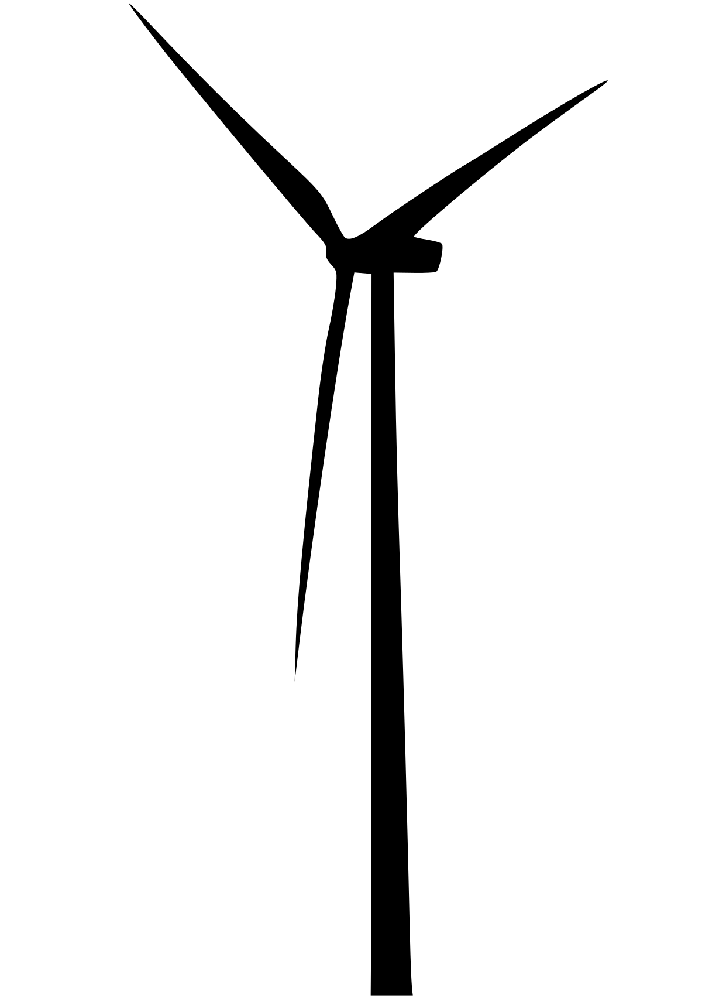

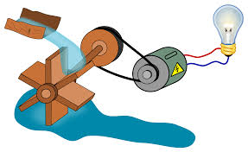
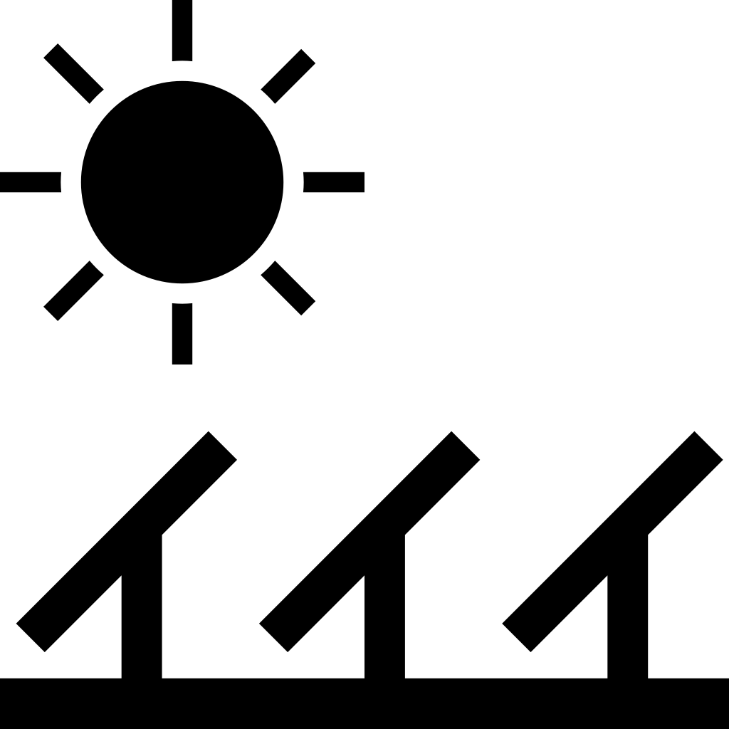

Classification of Energy Resources
5. Based on Origin
Fossil fuels energy
Nuclear energy
Hydro energy
Solar energy
Wind energy
Biomass energy
Geothermal energy
Tidal energy
Ocean Thermal energy
Ocean Wave energy

Slide 15
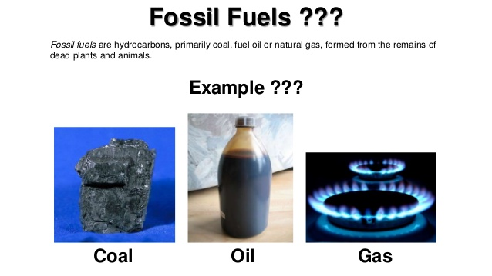
Conventional Energy Sources a)Fossil Fuel
  Fossil Fuels are non-renewable sources of energy, which, if exhausted, can not be replenished in a short time.
Their reserves are limited and are considered very precious.
These are also contributing to the global environmental pollution.

Slide 16
b)Coal
Since the advent of industrialization coal has been most common source of energy.
In the last three decades, the world switched over from coal to oil as a Major source of energy because it is simpler and cleaner to obtain useful energy from oil.
Coal is a complex mixture of compounds of carbon, hydrogen and oxygen.
Small amounts of nitrogen and Sulphur compounds are also present in coal.
It is mainly available in Bihar, West Bengal, Orissa and Madhya Pradesh.
The big coal mines in our country are at Jharia and Bokaro in Bihar and at Raniganj in West Bengal.
It is considered as the backbone of the energy sector for its use in industry, transportation and electric power generation.

Slide 17
Petroleum or Oil
It is a dark coloured, viscous and foul smelling crude oil.
The petroleum means rock oil.
It is normally found under the crust of earth trapped in rocks.
The crude oil is a complex mixture of several solid liquid gaseous hydrocarbons mixed with water, salt and earth particles.
It is a natural product obtained from oil wells.
Some of the crude oil producing locations in our country are:
Ankleshwar and Kalol in Gujarat
Rudrasagar and Lakwa in Assam; and
Bombay high (off-shore area)

Slide 18
Natural Gas
It consists about 95% Methane and rest ethane and propane.
It occurs deep under the crust of the earth either alone or a long with oil above the petroleum deposits.
It is a product of petroleum mining.
The gas is available in Tripura, Jaisalmer, off-shore areas of Bombay High and in the Krishna – Godavari delta.
It is used as a domestic and industrial fuel.
The natural gas is now also available as CNG (Compressed Natural Gas) a substitution of petrol in automobiles.

Slide 19
Conventional Power Generation
Thermal Power
Thermal power is the "largest" source of power in India.
There are three types of power plants-
Steam Turbine Power Plants-use coal ,oil ,gas as fuel
Gas Turbine Power Plants-oil or gas as fuel
Diesel power Plants-Prime Mover is an IC Engine and diesel oil used as fuel

Slide 20
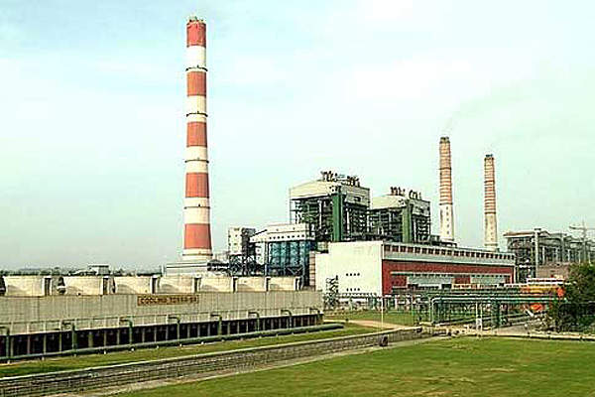
The Vindhyachal Thermal Power Station in the Singrauli district of Madhya Pradesh, with an installed capacity of 4,760MW, is currently the biggest thermal power plant in India. It is a coal-based power plant owned and operated by NTPC

Slide 21
Thermal Power Plants in Kerala
Name | Location | Capacity in MW | Year Opened
Brahmapuram Diesel Power Plant | Kochi | 106.6 | 1997
Kozhikode Diesel Power Project | Nallalam | 128 | 2000
Rajiv Gandhi Combined Cycle Power Plant(NTPC) | Kayamkulam | 359.58 | 1998

Slide 22
Advantages
Availability of Power is independent of weather conditions
Can be installed at any place where
Disadvantages
High Maintanence and operating cost
Polluting Source
Ash disposal difficulty
Long start up time

Slide 23
Hydro Electric Power
Potential energy of water is converted into Mechanical energy by using prime movers known as hydraulic turbines.
Water power is quite cheap where water is available in abundance.
Although capital cost of hydro electric power plants is higher as compared to other types of power plants but their operating Costs are quite low, as no fuel is required in this case

Slide 24
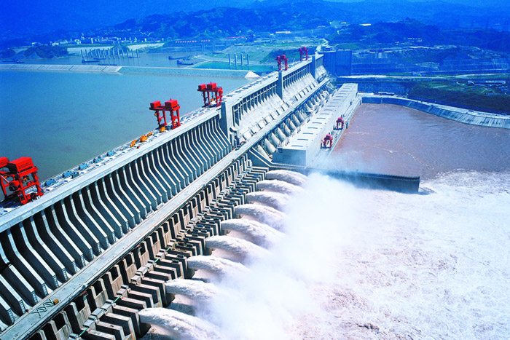
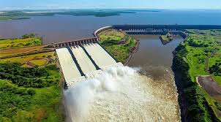
Hydo Electric Power Generation
The Three Gorges Dam in Hubei, China, has the world's largest instantaneous generating capacity (22,500 MW).
Itaipu Dam in Brazil/Paraguay in second place (14,000 MW).
Despite the large difference in installed capacity, these two power stations generate nearly equal amounts of electrical energy during the course of an entire year due to much variance in seasonal flow of Three Gorges dam

Slide 25
India is the seventh largest producer of Hydroelectric energy in the world.
Name | River | Location | Capacity (MW)
Tehri Dam | Bhagirathi | Uttarakhand | 2400 MW
Srisailam Dam | Krishna | Andhra Pradesh | 1670 MW
Nagarjunasagar | Krishna | Andhra Pradesh | 965 MW
Sardar Sarovar | Narmada | Gujarat | 1450 MW
Tehri dam is the highest Dam in India with a height of 260.5 metres. It is also listed in the top ten highest dams in the world.

Slide 26
In Kerala
Idukki Hydro Electric Project (IHEP) is the largest hydro electric project in Kerala. Installed capacity of this project is 780 MW. This is the first arch dam constructed in India. This is a double curvature parabolic arch dam, constructed across the river Periyar. With a height of 168.91 meters, this is a second highest dam in India.

Slide 27
Advantages
Low Start up time
No Pollutants
Longer Life
Disadvantages
Large area required
May affect ecological balance of the area
High initial cost
Long gestation period
Weather dependant

Slide 28
Nuclear Power
The heat produced by nuclear fission of the atoms of fissionable material is utilized in special heat exchangers for the production of steam which is then used to drive turbo generators as in the conventional power plants.

Slide 29
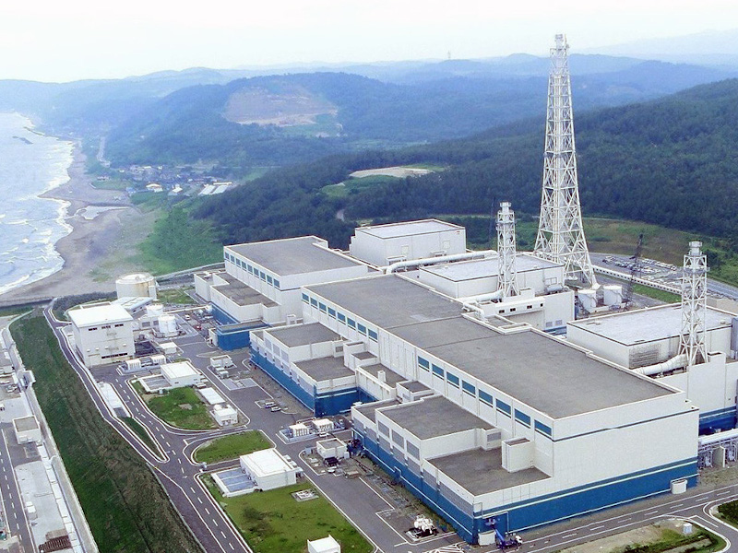
Largest nuclear power station of world, the Kashiwazaki-Kariwa (Japan) at 7,965 MW

Slide 30
Nuclear Power In India
Power station | Operator | State | Type | Units | Total capacity (MW)
Kudankulam^{[116]} | NPCIL | Tamil Nadu | VVER-1000 | 1000 × 2 | 2,000
Madras (Kalpakkam) | NPCIL | Tamil Nadu | PHWR | 220 × 2 | 440
Narora | NPCIL | Uttar Pradesh | PHWR | 220 × 2 | 440
Rajasthan | NPCIL | Rajasthan | PHWR | 100 × 1 200 x 1 220 × 4 | 1,080
Tarapur | NPCIL | Maharashtra | BWR PHWR | 160 x 2 540 × 2 | 1,400
Total |  |  |  |  | 7,380

Slide 31
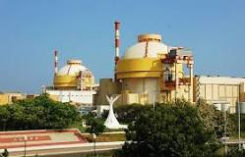
Kudankulam Nuclear Power Plant is located in the Tamil Nadu, Southern India. It is the highest-capacity nuclear plant in India, with a total of 2,000MW currently installed with a further 2,000MW under construction.

Slide 32
Advantages
Less area required
Less fuel required
Independent of weather conditions
Disadvantages
High Initial Cost
Radiation hazard
Expensive Fuel
Waste Disposal

Slide 33
Significance of Non Conventional Resources
Depletion of fossil fuels
Increase in energy demand
Pollution by fossil fuels-due to burning of coal ,major pollutants are emitted.
CO,CO2-Causes global warming
Hydrocarbons-damages ozone layer
Sulphur dioxide,Nitrogen oxides –respiratory problems
Projects like hydro power affect wildlife , cause deforestation
Radiation hazards and disposal of nuclear waste in the case of nuclear power plants.

Slide 34
The sources of energy which are being produced continuously in nature and are in exhaustible are called renewable sources of energy (or) non-conventional energy.
Some of these sources are:
1. Solar energy
2. Wind energy
3. Bio mass
4. Tidal energy
5. Wave energy
6. Geo thermal

Slide 35
COMPARISON OF CONVENTIONAL AND NON CONVENTIONAL SOURCES
Conventional sources of energy | Non-conventional sources of energy
These sources of energy are not abundant, present in limited quantity, e.g. coal, petroleum, natural gas. | These sources of energy are abundant in nature, e.g. solar energy, wind energy, tidal energy, biogas from biomass etc.
They have been in use for a long time. | They are yet in development phase over the past few years.
They are not replenished continuously. They are formed over a million years. | They are replenished continuously by natural processes.
They are called non-renewable sources of energy. | They are called renewable sources of energy.
They can be exhausted completely due to over-consumption except for hydel power. | They cannot be exhausted completely.
They pollute the environment by emitting harmful gases and also contribute to global warming. | They are environment-friendly, do not pollute the environment.
They are commonly used for industrial and commercial purposes. | They are used commonly used for household purposes.
Heavy expenditure is involved in using and maintaining these sources of energy. | Using these sources is less expensive.
They are used extensively, at a higher rate than the non-conventional sources. | They are not used as extensively as conventional sources.

Slide 36
Principles of Renewable Energy
The principles of renewable energy are based on utilizing natural, self-replenishing sources like the sun, wind, and water, which are not depleted with use.
Unlike fossil fuels, these sources are constantly renewed on a human timescale and have a lower environmental impact, often with zero or low carbon emissions.
Key principles include harnessing naturally occurring processes (like solar or wind) in the local environment, converting energy through different processes (mechanical, heat, or photon), and implementing systems that are often dispersed rather than centralized.

Slide 37
Sustainable energy
Affordable
Reliable
Clean & low carbon
Efficiently used
Accessible to all

Slide 38
Sustainable Energy Development
Renewable Energy Sources- Solar, Wind, Biomass, Ocean Energy etc
Energy Efficiency-Use of LED lighting, efficient motors, insulated buildings, smart grids, efficient appliances
Energy Access for All
Environmental Protection
Policy & Governance- Policies supporting: Renewable energy investments,Carbon pricing,Green energy subsidies,Research and innovation
Challenges-High initial cost of renewable systems,Energy storage limitations,Grid integration issues

Slide 39
1 | No poverty
2 | Zero hunger
3 | Good health and well-being
4 | Quality Education
5 | Gender equality
6 | Clean water and sanitation
7 | Affordable and clean energy
8 | Decent work and economic growth
9 | Industry, innovation and infrastructure
10 | Reduced inequalities
11 | Sustainable cities and economies
12 | Responsible consumption and production
13 | Climate action
14 | Life below water
15 | Life on land
16 | Peace, justice and strong institutions
17 | Partnership for the goals

Slide 40
Sustainable Development Goals (SDGs)
1 | No poverty
2 | Zero hunger
3 | Good health and well-being
4 | Quality Education
5 | Gender equality
6 | Clean water and sanitation
7 | Affordable and clean energy
8 | Decent work and economic growth
9 | Industry, innovation and infrastructure
10 | Reduced inequalities
11 | Sustainable cities and economies
12 | Responsible consumption and production
13 | Climate action
14 | Life below water
15 | Life on land
16 | Peace, justice and strong institutions
17 | Partnership for the goals

Slide 41
10/12/25 4th
1,12,13,14,25,27,40,56,61,65,67,68,71

Slide 42
World wide renewable energy
Renewable energy is globally abundant, widely available in every country, and rapidly expanding, already supplying over 30% of global electricity (mostly hydro, wind, solar) and set to become the largest power source by 2025-2026 driven by falling costs and huge capacity additions, especially in China, the U.S., and India, though faster deployment is needed to meet climate goals.
Solar, wind, hydro, geothermal, and biomass resources exist in all nations, reducing reliance on imported fossil fuels.

Slide 43
Solar and wind are now the most affordable new electricity sources in most regions, with falling prices making them highly competitive.
Renewables are expected to supply nearly 45% of global electricity by 2030
Worldwide solar installed capacity reached over 2.25 Terawatts (TW) by late 2024.

Slide 44
Solar Energy –Impact on environment
Solar energy is a very large, inexhaustible source of energy.
Solar energy is received in the form of radiation,can be converted directly or indirectly into other forms of energy, such as heat & electricity.
High Production Cost
Large Scale electricity generation requires large amount of land
Solar PV modules pose disposal problem due to presence of arsenic and cadmium
Hazards to eyesight from solar reflectors

Slide 45
12/12/25 1st hr
1,5,25,33,51,58,65,68

Slide 46
Major Solar Power Producers
China: 890 GW (dominating global capacity).
USA: 236 GW (driven by policies like the IRA).
India: 119 GW (rapid growth from rooftop and utility-scale projects).
Germany: 109 GW (strong rooftop solar adoption).
Japan: 100 GW (focus on floating solar).
The largest solar power plant in the world is the Bhadla Solar Park in Rajasthan, India, with an installed capacity of 2,245 MW. It covers approximately 14,000 acres.

Slide 47
Major Solar Power Plants In India
Bhadla Solar Park(Rajasthan) – 2,250MW(Largest solar power plant in the world).
Shakti Sthala solar power project(Karnataka) – 2,050MW
Ultra Mega Solar Park(Andhra Pradesh) – 1,000MW
Rewa Solar Power Project (Madhya Pradesh)– 750MW
Kamuthi solar power plant (Tamil Nadu)– 648MW

Slide 48
Wind Energy
Energy of wind can be economically used for the generation of electricity.
Winds are caused from 2 main factors:
1.Heating & cooling of the atmosphere which generates convection currents. Heating is caused by the absorption of solar energy on the Earth‘s surface & in the atmosphere.
2. The rotation of the Earth with respect to atmosphere & its motion around the sun

Slide 49
Impact on Environment
Large area required
Noise Pollution
Hazards for birds
Interference with television siganls

Slide 50
Top 5 Countries in wind power
1.China – installed capacity 560 GW
2. US – installed capacity 154GW
3. Germany – installed capacity 70W
4. India – installed capacit 50GW
5. Brazil,Spain – installed capacity 32GW
Worldwide wind installed capacity surpassed 1.1 Terawatts (TW) by the end of 2024

Slide 51
Wind Power in India
Muppandal, Tamil Nadu: Largest onshore farm (1500 MW).
Jaisalmer, Rajasthan: Second largest (1064 MW).
Brahmanvel, Maharashtra: 528 MW.
Dhalgaon, Maharashtra: 278 MW.
Vankusawade, Maharashtra: 259 MW.
Poolavadi, Tamil Nadu: 99 MW.

Slide 52
Major States for Wind Energy
Leading in Capacity: Gujarat and Tamil Nadu.
High Potential (120m height): Rajasthan, Gujarat, Maharashtra, Andhra Pradesh, Karnataka.

Slide 53
Roll No | state | Wind Potential at 120 m (GW) | Wind Potential at 150 m (GW)
1 | Andhra Pradesh | 74.90 | 123.3
2 | Gujarat | 142.56 | 180.8
3 | Karnataka | 124.15 | 169.3
4 | Madhya Pradesh | 15.40 | 55.4
5 | Maharashtra | 98.21 | 173.9
6 | Rajasthan | 127.75 | 284.2
7 | Tamil Nadu | 68.75 | 95.1
8 | Telangana | 24.83 | 54.7

Slide 54
Power Plant | Location | State | Capacity(MW) | Producer
Kutch Wind Farm (Gujarat Hybrid Renewable Energy Park) | Kutch | Gujarat | 11,500 (wind)+ 11,500 (solar + wind) | Adani Group^{[47]} Suzlon^{[48]}
Muppandal Wind Farm | Kanyakumari | Tamil Nadu | 1500 | Muppandal Wind
Jaisalmer Wind Park | Jaisalmer | Rajasthan | 1064 | Suzlon Energy
Brahmanvel windfarm | Dhule | Maharashtra | 528 | Parakh Agro Industries
Sidhpur-2 | Dwarka | Gujarat | 250.8 | KP Energy
Kayathar | Tutcorin | Tamilnadu | 300 | Siemens Gamesa, ReNew Power
Dhalgaon windfarm | Sangli | Maharashtra | 278 | Gadre Marine Exports

Slide 55
Biomass
Biomass is organic material from plants and animals used as a renewable energy source, including wood, crops, waste, and animal manure, that can be converted into heat, electricity, or biofuels, acting as a sustainable alternative to fossil fuels by recycling carbon in the atmosphere.
Sources: Agricultural residues (straw, crop waste), forestry waste (wood), animal manure, municipal solid waste, energy crops, and sewage sludge.
Biomass energy is considered carbon-neutral because plants absorb CO2 as they grow, releasing the same amount when used as fuel.

Slide 56
Conversion Methods:
Direct Combustion: Burning biomass to heat water, create steam, and drive turbines for electricity.
Gasification/Pyrolysis: Heating biomass to create syngas or bio-oil.
Anaerobic Digestion: Microbes break down organic matter to produce biogas (methane).
Fermentation: Converting plant sugars into ethanol.
Uses: Electricity generation, heating, and production of transportation fuels like biodiesel and bioethanol.

Slide 57
China: World leader in total biopower capacity (approx. 31 GW in 2023) and production (25% of global biopower), using agricultural waste and waste-to-energy.
United States (US): Major player, with ~11 GW capacity, and a top producer of ethanol.
Brazil: Huge biopower presence (18 GW capacity), especially from sugarcane byproducts for biofuels (ethanol).
India: Growing significantly, with ~11 GW capacity and major biofuel (ethanol/biodiesel) growth, becoming a top producer.
Indonesia: Leading biodiesel producer (palm oil) and a significant contributor to biomass energy.

Slide 58
Dominant Sources: China uses waste, Brazil uses sugarcane, US uses corn/soy, Indonesia uses palm oil
Biopower vs. Biofuels: Some countries lead in electricity (China, US, Brazil), while others lead in liquid biofuels (US, Brazil, Indonesia).

Slide 59
Biomass power in India
India has a significant biomass power sector with a cumulative installed capacity of over 11.5 GW as of March/October 2025, encompassing biomass power, bagasse/non-bagasse cogeneration, and waste-to-energy, with major contributions from states like Maharashtra, Karnataka, and Andhra Pradesh.

Slide 60
Bagasse cogeneration is a process that uses the fibrous residue from sugarcane, called bagasse, to simultaneously generate electricity and steam.
This is a highly efficient form of renewable energy, where the sugar mill uses the generated power and steam for its own needs and can export surplus electricity to the grid.
It is a common practice in sugar-producing countries to make the mills self-sufficient and generate additional income from selling surplus power.
Leading States: Maharashtra (approx. 2,907 MW), Uttar Pradesh (approx. 1,985 MW), Karnataka (approx. 1,869 MW).

Slide 61
Geothermal Energy
Geothermal energy is the heat or steam that comes from the earth’s subsurface. It is found in the rocks and fluids below the earth’s crust and can be traced as far down to the core that contains hot molten rock, magma.
In order to generate power from geothermal energy, a mile deep wells are dug into underground reservoirs to access the steam and hot water, which are used to drive turbines connected to electricity generators.

Slide 62
Huge Potential
Geothermal Is a Reliable & Renewable Source of Energy
Geothermal Systems are Highly Efficient
Geothermal Systems Need Little or No Maintenance
Greenhouse Emissions
Geothermal System has High Investment Costs
Geothermal Energy is Location-Specific
Co2 emission less compared to thermal plants

Slide 63
Impacts
Gases escaping to atmosphere like H2S are oxidized to SO2 and H2SO4 and drop down as acid rain
Noise pollution caused by exhausts,blow downs and centrifugal separation.Can be controlled by silencers
Discharge of hot water to river affects drinking water , farming and fisheries
Chemicals like sulphates, chlorides and carbonates of lead , boron and arsenic pollute soil and water
Large scale withdrawal of underground fluids may trigger damage to surface structures.

Slide 64
Top Countries by Capacity (approx. 2024/2025)
United States: Leading producer with the most installed capacity (around 3.9 GW).
Indonesia: Second largest, with significant development.
Philippines: A major player, ranking third globally.
Turkey: Rapidly growing, placing fourth.
New Zealand: Strong capacity, often above 1 GW.

Slide 65
India's geothermal energy potential is substantial, estimated at over 10,000 MW, though the sector is still in its early stages.
The country has identified around 340 hot springs, with the most promising sites for power generation including the Puga valley in Ladakh, which is set to host India's first geothermal power project.
Other promising locations for geothermal power plants include Manikaran (Himachal Pradesh), Jalgaon (Maharashtra), Tapovan (Uttarakhand), Bakreshwar (West Bengal), and Tuwa (Gujarat).

Slide 66
Ocean Thermal Energy Conversion (OTEC)
Ocean Thermal Energy Conversion (OTEC) uses the ocean thermal gradient between cooler deep and warmer shallow or surface seawaters to run a heat engine and produce useful work, usually in the form of electricity.

Slide 67
Impacts
Leakage of ammonia used as working fluid may cause great damage to eco system
Hazards to fishes
An OTEC plant displaces nearly 4 cumec water per MW generation
This disturbs thermal balance ,salinity gradient and creaters adverse effect on marine environmnet

Slide 68
United States (Hawaii) hosts the largest operational test/demonstration facilities (like Makai's 100kW plant at Natural Energy Laboratory of Hawaii Authority) and is a leader in OTEC development, with China, Japan, and India also heavily involved in research and pilot projects.

Slide 69
Current OTEC project in India
Location: Kavaratti, Lakshadweep.
Purpose: To power a desalination plant that will produce about 100,000 to 150,000 liters of potable water per day.
Technology: The plant is based on the closed-cycle OTEC method, which uses a working fluid like ammonia to generate electricity by harnessing the temperature difference between surface and deep ocean waters.
Power Generation: The OTEC plant is projected to generate between 60 and 65 kW of power.
Significance: This is India's first OTEC plant and a pioneering effort to provide clean drinking water using a green energy source

Slide 70
Sihwa Lake Tidal Power Station (South Korea): The world's largest, with 254 MW capacity, improving water quality in the lake.
La Rance Tidal Power Station (France): The first and second-largest, operating since the 1960s with 240 MW.
Annapolis Royal Generating Station (Canada): A significant plant in Nova Scotia, around 20 MW.
Jiangxia Tidal Power Plant (China): Operational since the 1980s, with a smaller capacity (around 3.2 MW).

Slide 71
Tidal Power in India
Gulf of Kutch, Gujarat: Considered the leading site, with plans for a 50 MW pilot project near Mandvi and a larger 200 MW project by Gujarat Power Corporation Ltd (GPCL) and Atlantis Resources.
Durgaduani Creek, Sundarbans, West Bengal: A 3.75 MW demonstration project was approved but faced delays due to cost and ecological risks, despite detailed plans.

Slide 72
Wind Energy

Slide 73
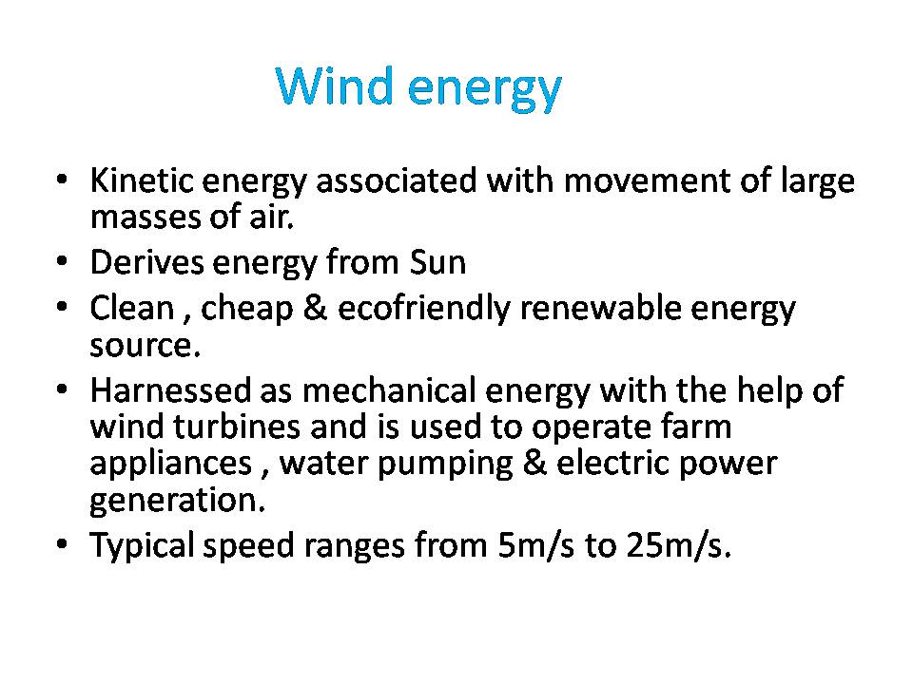

Slide 74
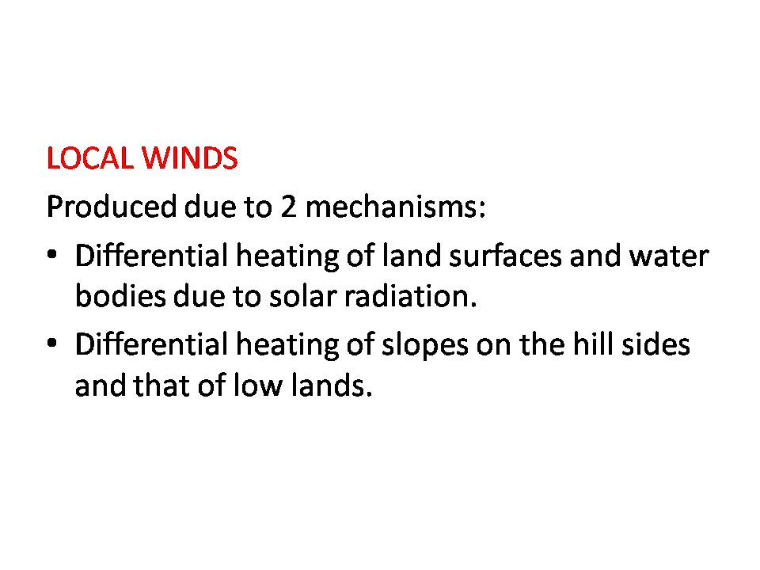

Slide 75
Wind energy is created when the atmosphere is heated unevenly by the Sun, some patches of air become warmer than others. These warm patches of air rise, other air rushes in to replace them –thus, wind blows.
A wind turbine extracts energy from moving air by slowing the wind down, and transferring this energy into a spinning shaft , which usually turns a generator to produce electricity.

Slide 76
Wind Power
How Does it Work?
Wind power is generated by the force wind exerts on the blades of a turbine, causing the turbine's shaft to rotate at a speed of 10 to 20 revolutions per minute (rpm). The rotor shaft is connected to a generator that converts mechanical energy into electrical energy.
The amount of energy generated by a wind turbine depends on:
wind speed (main factor)
the area swept by the blades
air density

Slide 77
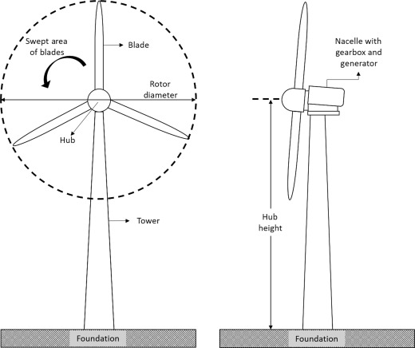

Slide 78
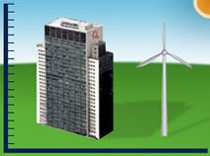
Wind turbines require:
a minimum wind speed (generally 12-14 km/h) to begin turning and generate electricity
strong winds (50-60 km/h) to generate at full capacity
winds of less than 90 km/h; beyond that speed, the turbines must be stopped to avoid damage
Since wind speed increases with elevation above ground, wind turbines are installed on towers that are often as tall as a 20-storey building.

Slide 79
Under optimal conditions, the efficiency of a wind generator in converting energy to electricity is about 45%

Slide 80
History
Wind energy has been harnessed for centuries to propel sailing vessels and turn grist mills and water pumps.
Today, wind is used increasingly to generate electricity.
Turbines with large propellers are erected on ‘wind farms’ located in strategic areas that have good wind regimes and that are in proximity to existing electrical grids.
Wind energy is captured only when the wind speed is sufficient to move the turbine blades, but not in high winds when the turbine might be damaged if operated

Slide 81
Technology transition “windmills” to “wind turbines”

Slide 82
Basic principles of Wind Energy Conversion Systems (WECS)
Wind possesses energy by virtue of its motion. Any device capable of slowing down the mass of moving air, like a sail or propeller, can extract part of the energy and convert into useful work.
There are three factors determine the output power generated from the wind mill , they are
(1)The wind speed
(2)The cross section of wind swept by rotor, and
(3)The overall conversion efficiency of rotor, transmission system and generator pump.

Slide 83
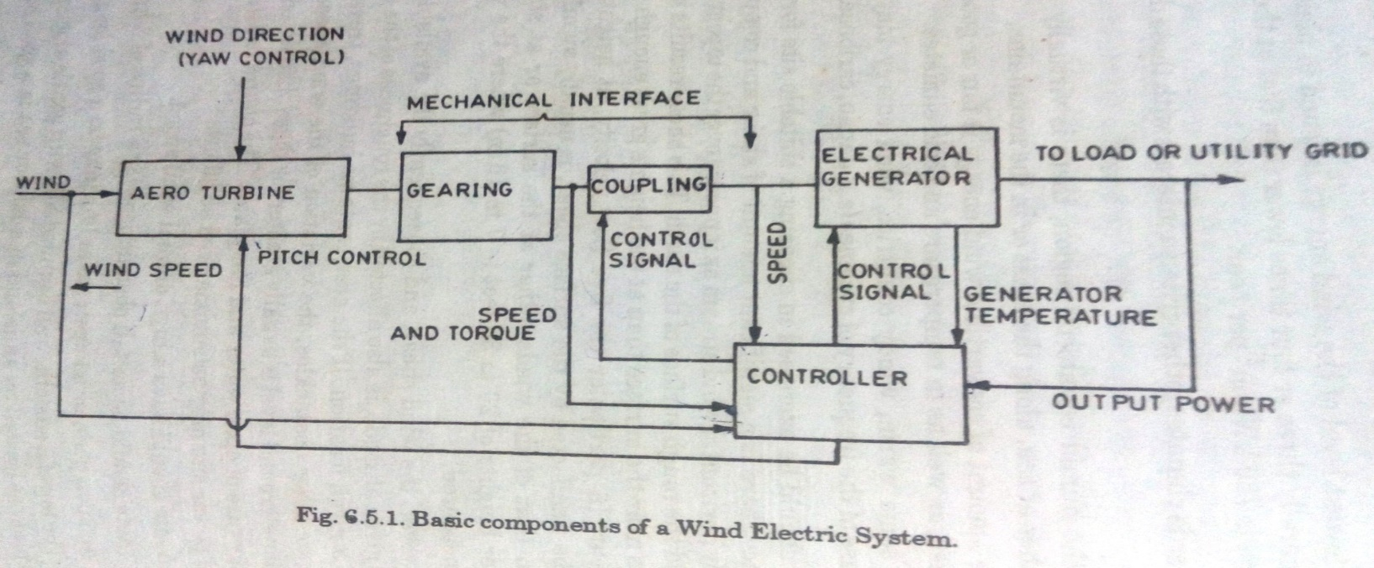
Components of Wind Energy System

Slide 84
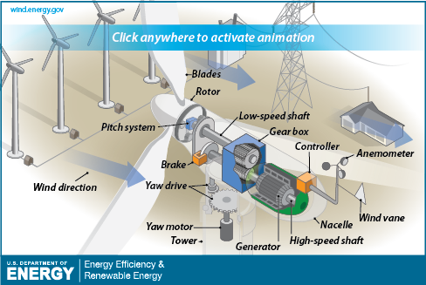

Slide 85
Anemometer:
Measures the wind speed and transmits wind speed data to the controller.
Blades:
  Lifts and rotates when wind is blown over them, causing the rotor to spin. Most turbines have either two or three blades.
Brake: Stops the rotor mechanically, electrically, or hydraulically, in emergencies.
Controller: Starts up the machine at wind speeds of about 8 to 16 miles per hour (mph) and shuts off the machine at about 55 mph. Turbines do not operate at wind speeds above about 55 mph because they may be damaged by the high winds.

Slide 86
Gear box:
  Connects the low-speed shaft to the high-speed shaft and increases the rotational speeds from about 30-60 rotations per minute (rpm), to about 1,000-1,800 rpm; this is the rotational speed required by most generators to produce electricity.
Generator:
  Produces 50-cycle AC electricity; it is usually an induction generator.
High-speed shaft:Drives the generator.
Low-speed shaft:Turns the low-speed shaft at about 30-60 rpm.

Slide 87
Nacelle: Sits atop the tower and contains the gear box, low- and high-speed shafts, generator, controller, and brake.
Pitch: Turns (or pitches) blades out of the wind to control the rotor speed, and to keep the rotor from turning in winds that are too high or too low to produce electricity.
Rotor: Blades and hub together form the rotor.
Tower: Made from tubular steel (shown here), concrete, or steel lattice. Supports the structure of the turbine. Because wind speed increases with height, taller towers enable turbines to capture more energy and generate more electricity.

Slide 88
Wind vane: Measures wind direction and communicates with the yaw drive to orient the turbine properly with respect to the wind.
Yaw drive: Orients upwind turbines to keep them facing the wind when the direction changes. Downwind turbines don't require a yaw drive because the wind manually blows the rotor away from it.
Yaw motor: Powers the yaw drive.

Slide 89
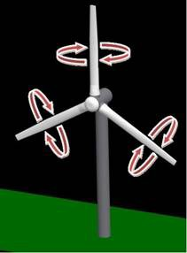
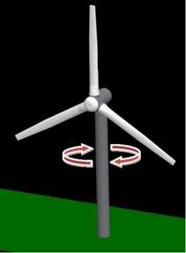
Pitch control Yaw control

Slide 90

Yaw Control

Slide 91
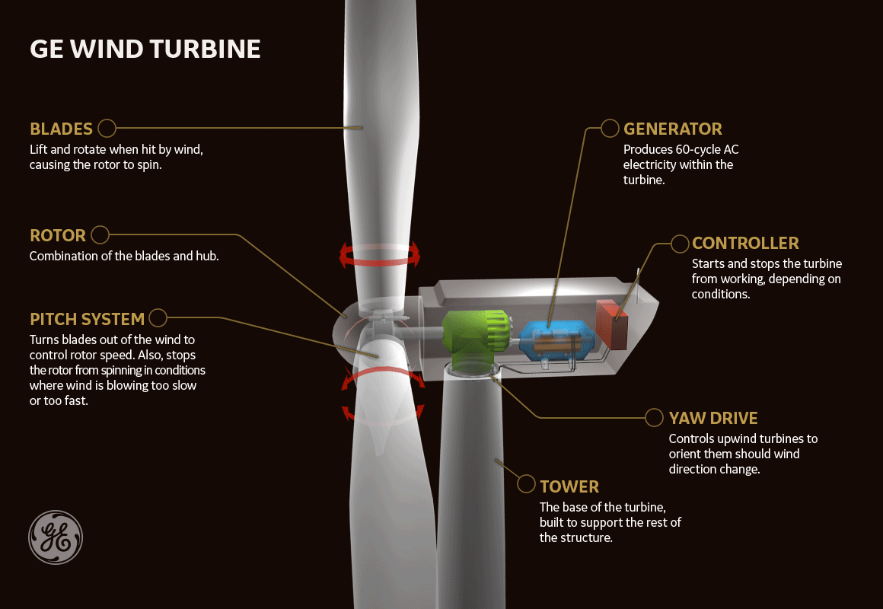

Slide 92
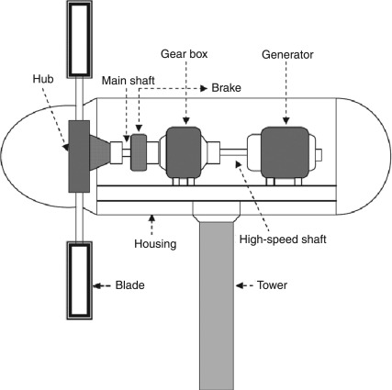

Slide 93
The purpose of pitch control is to maintain the optimum blade angle to achieve certain rotor speeds or power output.
You can use pitch adjustment to stall and furl, two methods of pitch control.
By stalling a wind turbine, you increase the angle of attack, which causes the flat side of the blade to face further into the wind.
Furling decreases the angle of attack.
Pitch angle adjustment is the most effective way to limit output power by changing aerodynamic force on the blade at high wind speeds.
Yaw refers to the rotation of the entire wind turbine in the horizontal axis. Yaw control ensures that the turbine is constantly facing into the wind to maximize the effective rotor area and, as a result, power.

Slide 94
Wind speed fluctuates, which has an impact on wind electricity generation capacity and operating characteristics. In general, wind speeds are as follows:
8 kph (2 m/s) minimum is required to start rotating most small wind turbines.
12.6 kph (3.5 m/s) is the typical cut-in speed, when a small turbine starts generating power.
36–54 kph (10–15 m/s) produces maximum generation power.
At 90 kph (25 m/s) maximum, the turbine is stopped or braked (cut-out speed).

Slide 95
Classification

Slide 96
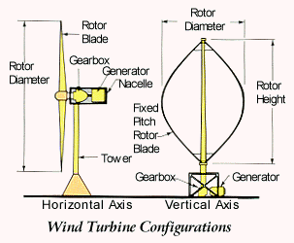
Types Based on orientation of the axis of rotation of the rotor
•Horizontal axis wind turbine (HAWT)
•Vertical axis wind turbine (VAWT)

Slide 97
Horizontal axis wind turbine (HAWT)
HAWTs have their shafts mounted horizontally parallel to the ground.
HAWTs are the most common and usable wind turbine type .
The electric generator and the rotor shaft, which is fitted horizontally to the ground, are placed on the top of a tall tower.
The blades of the rotor are forced to rotate due to the air flow.
The rotor shaft meshes with the generator, and consequently, the rotor shaft rotation leads to electricity generation..

Slide 98
This type of turbine is usually designed to ensure that the rotor blades are facing the wind , thus it utilizes wind sensor and servo motor.
High wind speeds could be dangerous and may cause damage to the wind turbine; to prevent that, the turbine is fitted with a brake to reduce rotor shaft speed.
The main HAWT advantages are the tall towers, which result in more powerful wind with wind shear, leading to an upsurge in the turbine output power.
Moreover, they can be installed offshore, in forests above trees or uneven land.
The disadvantages of the HAWTs is that they need a brake mechanism to slow down the rotor blades in the case of strong wind and a supplementary mechanism is required to allow the rotor blades to be turned in the direction of the wind

Slide 99
Windmills have multiple blades
  need to provide high starting torque to overcome weight of the pumping rod
  must be able to operate at low windspeeds to provide nearly continuous water pumping
  a larger area of the rotor faces the wind
Turbines with many blades operate at much lower rotational speeds - as the speed increases, the turbulence caused by one blade impacts the other blades
Most modern wind turbines have two or three blades

Slide 100
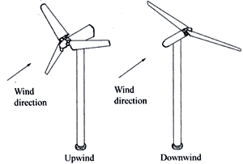
Horizontal Axis Wind Turbines
•“Upwind” HAWT –blades are in front of (upwind of) the tower
•Most modern wind turbines are of this type
•Blades are “upwind” of the tower
•Require somewhat complex yaw control to keep them facing into the wind
•Operate more smoothly and deliver more power

Slide 101
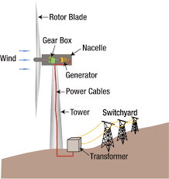

Slide 102
Types of Horizontal axis turbine

Slide 103
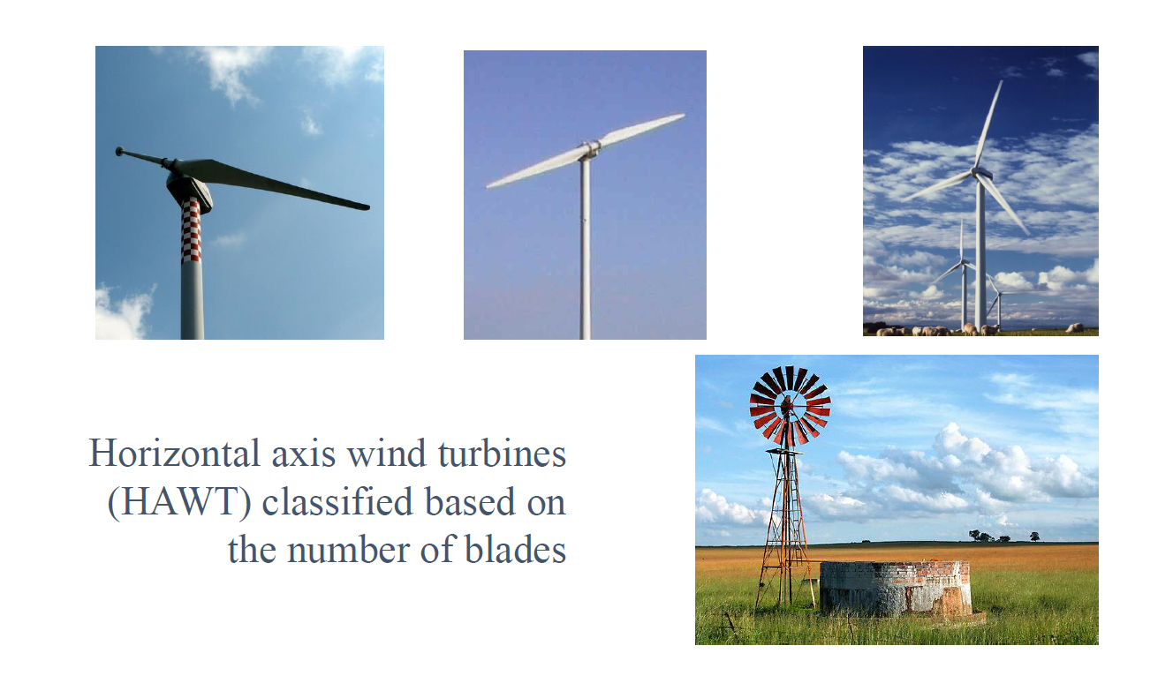

Slide 104
1.Single-Blade Turbines
•A long blade is mounted on a rigid hub
•If extremely large blades are mounted on rigid hub, large blade root bending moments may occur due to tower shadow, gravity and sudden shifts in wind directions.
•To reduce rotor cost ,low cost counter weight are recommended.
Advantages
•1. Least expensive
•2.Simple blade controls
•3. Easiest to erect because of its lightweight and because the blade can be mounted while it is on the ground
•4. Requires the smallest and lightest tower
Disadvantages
•1. Noisier than the three-blade turbine
•2. Must run at the highest speed to produce the same amount of electrical power
•3. Vibration produced at the blade
•4.Large blade root bending moment
•5.Unconventional appearance

Slide 105
Single Blade
Three Blade
Two Blade

Slide 106
Two-Blade Turbine
➢Rotor drives generator through a step up gearbox
➢Two-blade turbines have experienced high fatigue failures of the blade and other mechanical parts, so they have limited application
Advantages
1.Initial cost and weight are lower and they are simpler to mount
2.Produces more energy than the single-blade turbine
Disadvantages
1.Noisier than the three-blade turbine
2.Produces less energy than the three-blade turbine(when blade size and speed are the same)

Slide 107
17/12/25 4th
13,18,21,25,62,64,69

Slide 108
Three-Blade Turbine
•majority of large horizontal-axis wind turbines use three blades, with the rotor position maintained upwind by the yaw control.
•provides the most energy conversion while limiting noise and vibration.
•The three blades provide more blade surface for converting wind energy into electrical energy than a two-blade or single-blade wind turbine.
Advantages
1. Quietest of the three types of turbines
2. Least amount of vibration
3. Available blade pitch control allows the blade to catch the maximum amount of wind
4. Lowest energy cost
Disadvantages
1. Heavier than single-and two-blade turbines
2. Most capital-expensive of the three types
3. Requires active yaw control to make blades face into the wind
4. Requires the largest cranes to construct
5. Requires the largest and heaviest tower
6. Larger blades are more difficult to transport to the tower site

Slide 109
Single-bladed designs are not very popular due to problems in balancing and visual acceptability
Two-bladed rotors also have these drawbacks, but to a lesser extent.
Most of the modern wind turbines employed for electricity generation have three-bladed rotors.
The loading pattern for these rotors is relatively uniform and they are visually more acceptable.

Slide 110
Horizontal axis Dutch type Windmill
•One of the oldest designs
•Blades are made from an array of wooden slats which feather at high wind speeds
Horizontal axis Multiblade Windmill:
•Modern water pumping windmills have a large number of blades-generally wooden or metallic-driving a reciprocating pumps. (water pumping)
•Have high strength to weight ratio
•Have good power coefficient
•High starting torque
•Simplicity and low cost
Sail type
•is of Recent origin
•Blade surface is made from cloth, nylonor plastics arranged sail wings

Slide 111
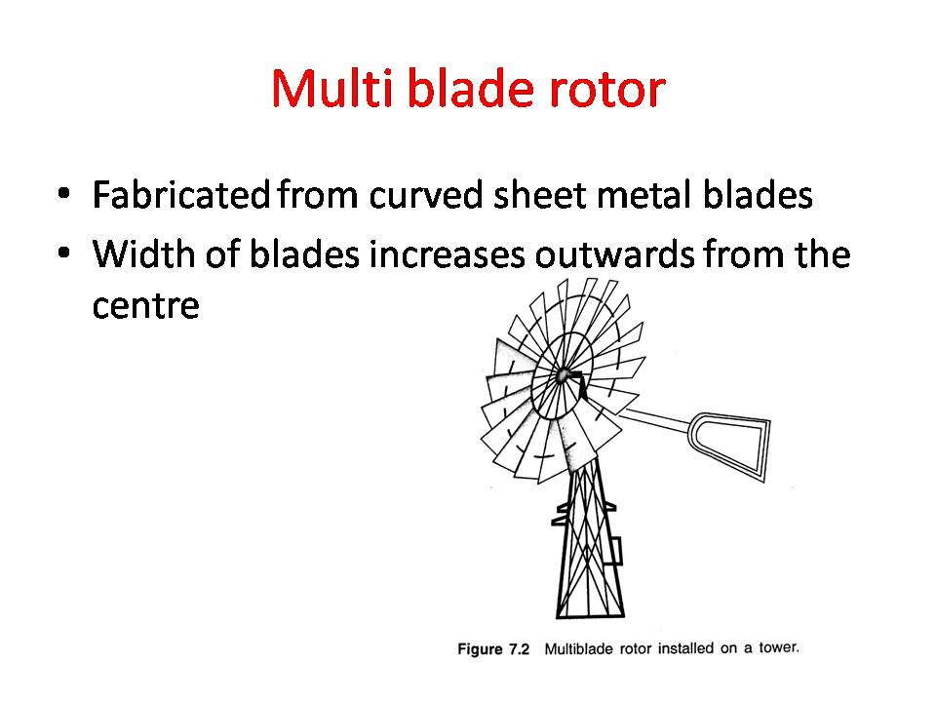

Slide 112
Further, a HAWT can have upwind- or downwind-type rotors.
An upwind turbine has its rotor fixed in front of the unit, directly facing the incoming wind stream .
In contrast, the downwind turbines have their rotors positioned at the back side, leaving the nacelle to face the wind first. The major advantage of upwind rotors is that they do not suffer from the tower shadow effect.
However, upwind rotors are to be placed at some distance from the tower and a yaw mechanism is essential to keep the rotor always facing the wind.
On the other hand, downwind machines are more flexible and may not require the yaw mechanism.
This makes these designs relatively cheaper. But, as the rotors are placed at the leeward side of the tower , there may be uneven loading on the blades as they pass through the shadow of the tower.

Slide 113
Horizontal Axis Wind Turbines
•“Upwind” HAWT –blades are in front of (upwind of) the tower
•Most modern wind turbines are of this type
•Blades are “upwind” of the tower
•Require somewhat complex yaw control to keep them facing into the wind
•Operate more smoothly and deliver more power

Slide 114
Advantages of Horizontal Axis Machines
•The efficiency is higher than that of vertical axis machines since the blades always move perpendicularly to the wind, receiving power through the whole rotation.
•The tall tower base allows access to stronger wind in sites with wind shear
•They are easier to mount high
•They are self starting.
•They are less expensive.
•The technology is better developed.
•They are available commercially.

Slide 115
Disadvantages of Horizontal Axis Machines
Massive tower construction is required to support the heavy blades, gearbox, and generator.
•Many of the important parts that require maintenance are high off the ground.
•A yaw mechanism must be in place to turn the turbine into the wind.
•HAWTs generally require a braking or yawing device in high winds to stop the turbine from spinning and destroying or damaging itself.
•Cyclic Stresses & Vibration

Slide 116
Terms used in wind energy
TSR refers to the ratio between the wind speed and the speed of the tips of the wind turbine blades.
Wind turbines must be designed with optimal tip speed ratios to get the maximum amount of power from the wind.
TSR (λ) =Tip Speed of Blade/ Wind Speed

Slide 117
Drag Force
Force component in line with velocity of the wind.
Lift Force
Force component perpendicular to drag force.
Cut in Speed
It is the wind speed at which a wind turbine starts to operate.
Cut Out Speed
It is the wind speed at which a wind turbine is designed to shut down to prevent damage from high wind speeds. It is also known as furling wind speed.

Slide 118
Blade designs operate on either the principle of drag or lift.
For the drag design, the wind literally pushes the blades out of the way. Drag powered wind turbines are characterized by slower rotational speeds and high torque capabilities. They are useful for the pumping, sawing or grinding work.
The lift blade design employs the same principle that enables airplanes, kites and birds to fly. The blade is essentially an airfoil, or wing. When air flows past the blade, a windspeed and pressure differential is created between the upper and lower blade surfaces.
The pressure at the lower surface is greater and thus acts to "lift" the blade. When blades are attached to a central axis, like a wind turbine rotor, the lift is translated into rotational motion. Lift-powered wind turbines have much higher rotational speeds than drag types and therefore well suited for electricity generation.

Slide 119
The tip-speed is the ratio of the rotational speed of the blade to the wind speed.
The larger this ratio, the faster the rotation of the wind turbine rotor at a given wind speed.
Electricity generation requires high rotational speeds.
Lift-type wind turbines have maximum tip-speed ratios of around 10, while drag-type ratios are approximately 1.
Given the high rotational speed requirements of electrical generators, it is clear that the lift-type wind turbine is most practical for this application.

Slide 120
The rated speed is the minimum wind speed at which the wind turbine will generate its designated rated power.
For example, a "10 kilowatt" wind turbine may not generate 10kilowatts until wind speeds reach 40 kmph. Rated speed for most machines is in the range of 40 to 55 kmph.
At wind speeds between cut-in and rated, the power output from awind turbine increases as the wind increases.
Most manufacturers provide graphs, called "power curves,"showing how their wind turbine output varies with wind speed.

Slide 121
Maximum Power Coefficient:-
The maximum power coefficient of the wind energy can be defined as the ratio of the convertible power to the theoretically maximum power from the available wind energy.
In practice power coefficients of 20-30% are common

Slide 122
Betz limit
It is the flow of air over the blades and through the rotor area that makes a wind turbine function. The wind turbine extracts energy by slowing the wind down.
The theoretical maximum amount of energy in the wind that can be collected by a wind turbine's rotor is approximately 59%. This value is known as the Betz limit.

Slide 123
Vertical Axis Wind Turbines
•Rotor axis is vertical and remains perpendicular to the wind stream
•Darrieus rotor -the only vertical axis machine with any commercial success
•The main advantage of this arrangement is that the wind turbine does not need to be pointed into the wind. This is an advantage on sites where the wind direction is highly variable or has turbulent winds.
•No yaw (rotation about vertical axis) control needed to keep them facing into the wind
•Heavy machinery in the nacelle is located on the ground
•Blades are closer to ground where wind-speeds are lower

Slide 124
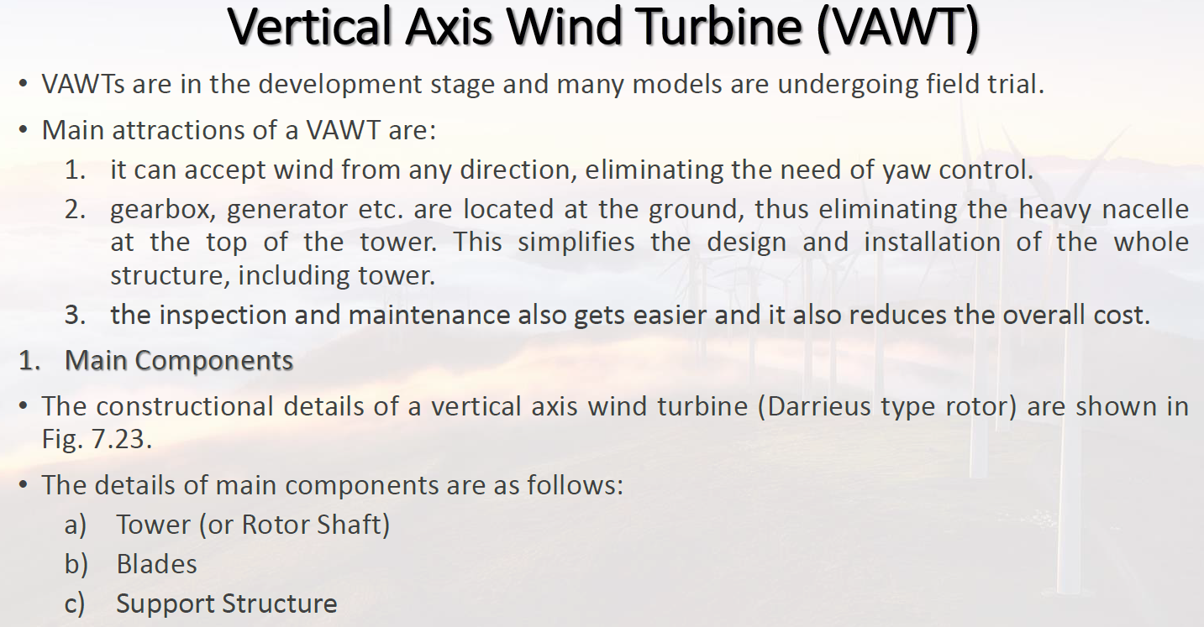

Slide 125
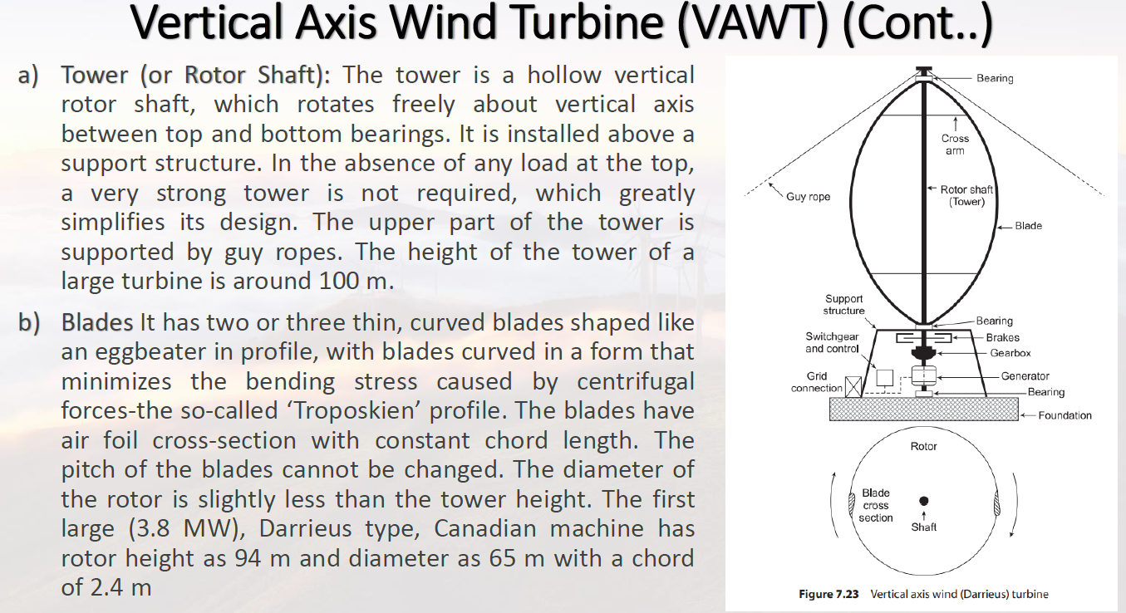

Slide 126
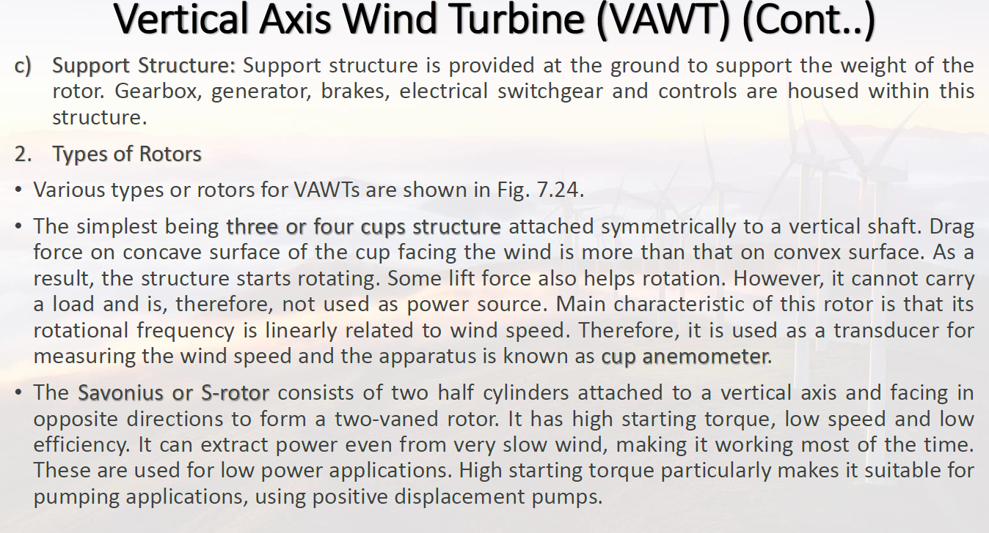

Slide 127
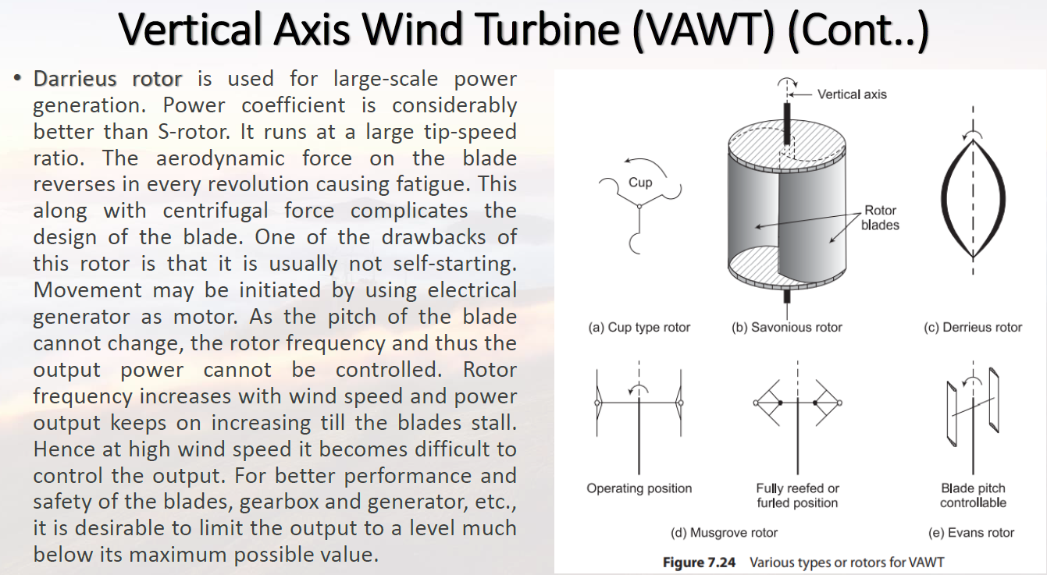

Slide 128
Disadvantages of Vertical Axis Machines
Efficiency is very low compared to HAWTS.
•Most vertical axis machines are not self starting .They need an initial push to start; this initial push that to make the blades start spinning on their own must be started by a small motor.
•They have relative high vibration because the air flow near the ground creates turbulent flow.
•Because of vibration, bearing wear increases which results in the increase of maintenance costs.
•They can create noise pollution.
•VAWTs may need guy wires to hold it up (guy wires are impractical and heavy in farm areas).
•Maintenance is usually more difficult.

Slide 129
Advantages of Vertical Axis Machines
•They can produce electricity in any wind direction.
•Strong supporting tower in not needed because generator, gearbox and other components are placed on the ground.
•Low production cost as compared to horizontal axis wind turbines.
•As there is no need of pointing turbine in wind direction to be efficient so yaw drive and pitch mechanism is not needed.
•Easy installation as compared to other wind turbine.
•Easy to transport from one place to other.
•Low maintenance costs.
•They can be installed in urban areas.
•Low risk for human and birds because blades moves at relatively low speeds.
•They are particularly suitable for areas with extreme weather conditions, like in the mountains where they can supply electricity to mountain huts.

Slide 130
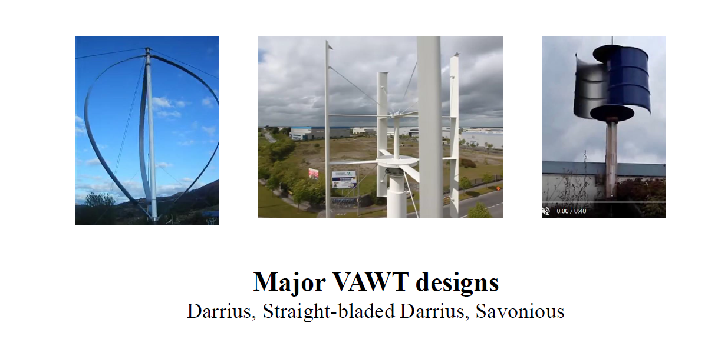

Slide 131
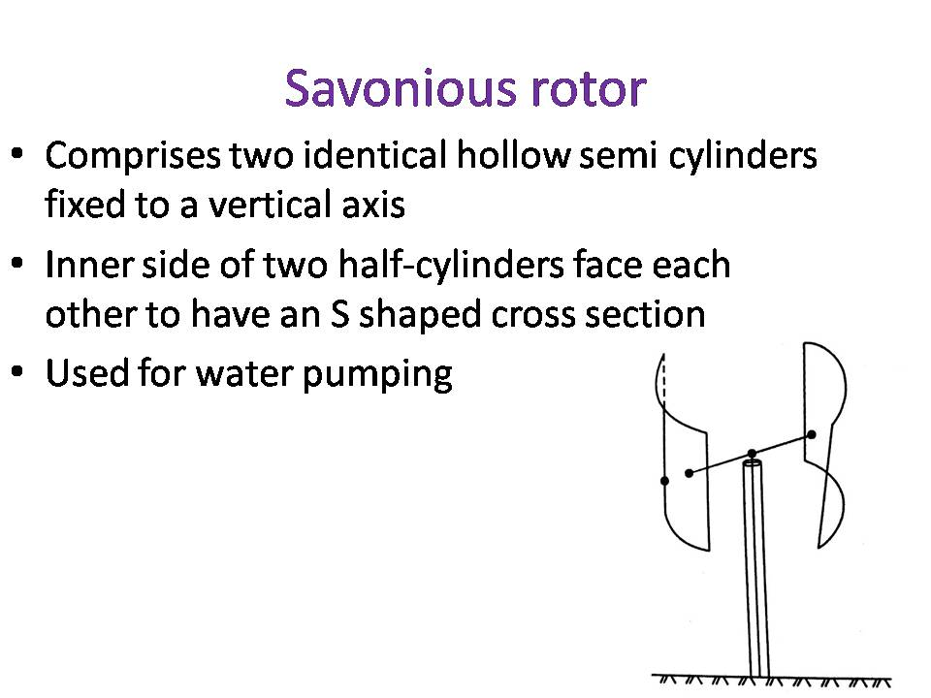

Slide 132
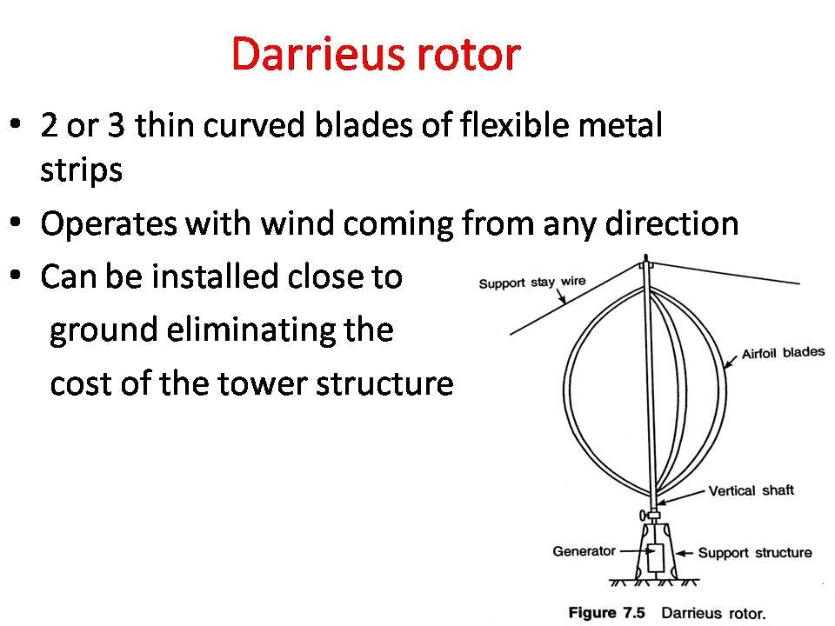

Slide 134
19/12/25 1st hour
1,4,5,10,13,14,18,21,25,33,34,52,64,67,68,69,70,71,72

Slide 135

Output power Equation
Kinetic Energy = 0.5 x Mass x Velocity² , where the mass is measured in kg, the velocity in m/s, and the energy is given in joules.
Air has a known density (around 1.23 kg/m³ at sea level),
So the mass of air hitting our wind turbine. (which sweeps a known area) each second is given by the following equation: Mass/sec (kg/s) = Velocity (m/s) x Area (m² ) x Density (kg/m³ ).
Therefore, the power (i.e. energy per second) in the wind hitting a wind turbine with a certain swept area is given by simply inserting the mass per second calculation into the standard kinetic energy equation given above resulting in the following vital equation:
Power = 0.5 x Swept Area x Air Density x Velocity³ , where Power is given in Watts (i.e. joules/second), the Swept area in square metres, the Air density in kilograms per cubic metre, and the Velocity in metres per second.

Slide 136
The equation for wind power(P) is given by
P= 0.5 x ρ x A x Cp x V³ x Ng x Nb
where, ρ = Air density in kg/m3 , A = Rotor swept area (m2 ). Cp = Coefficient of performance V = wind velocity (m/s) Ng = generator efficiency Nb = gear box bearing efficiency

Slide 137
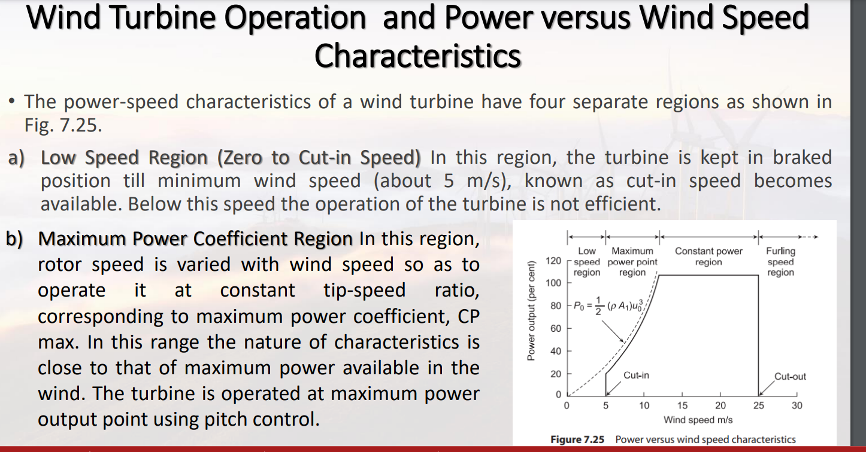

Slide 138
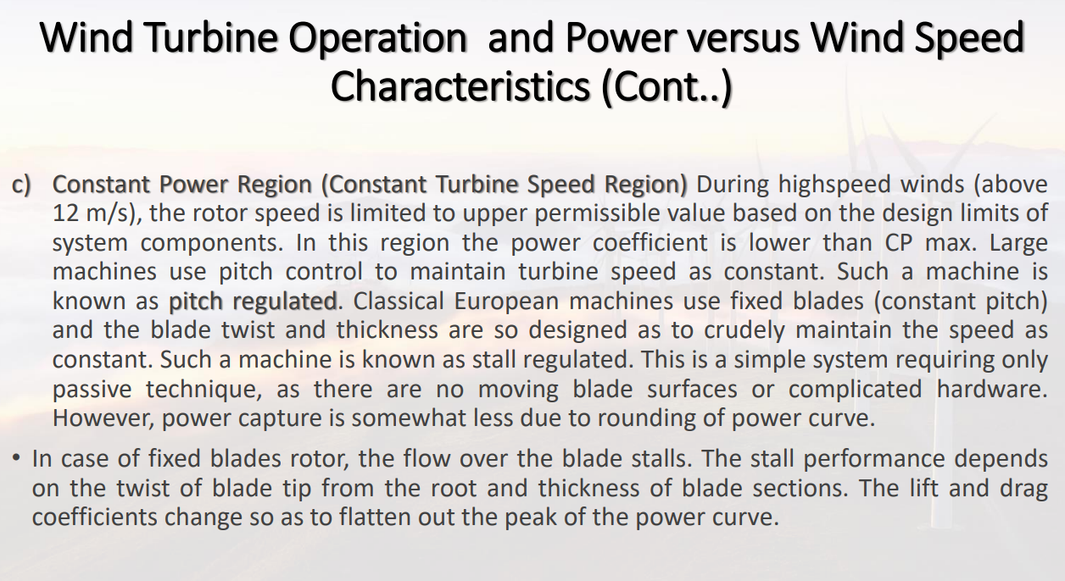

Slide 139
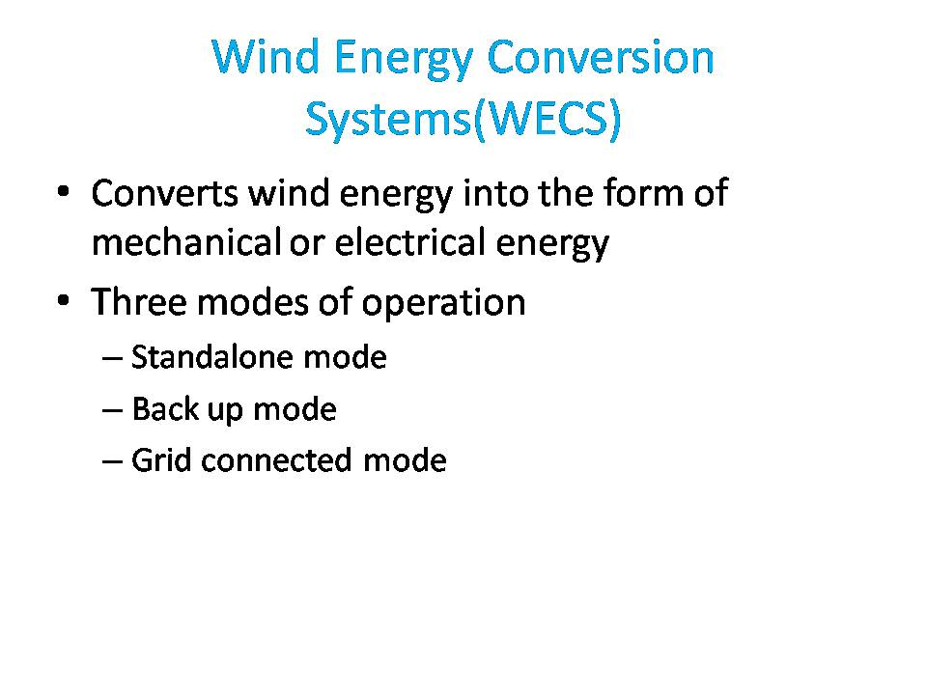

Slide 140
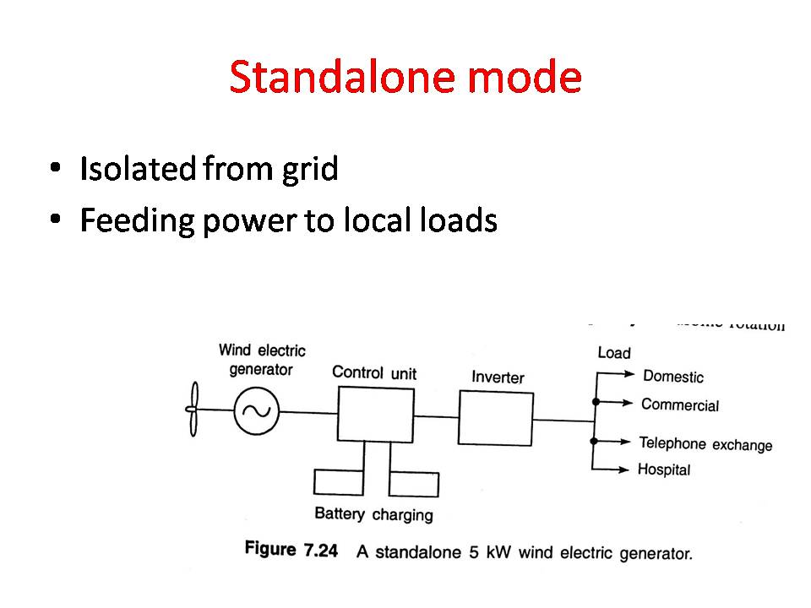

Slide 141
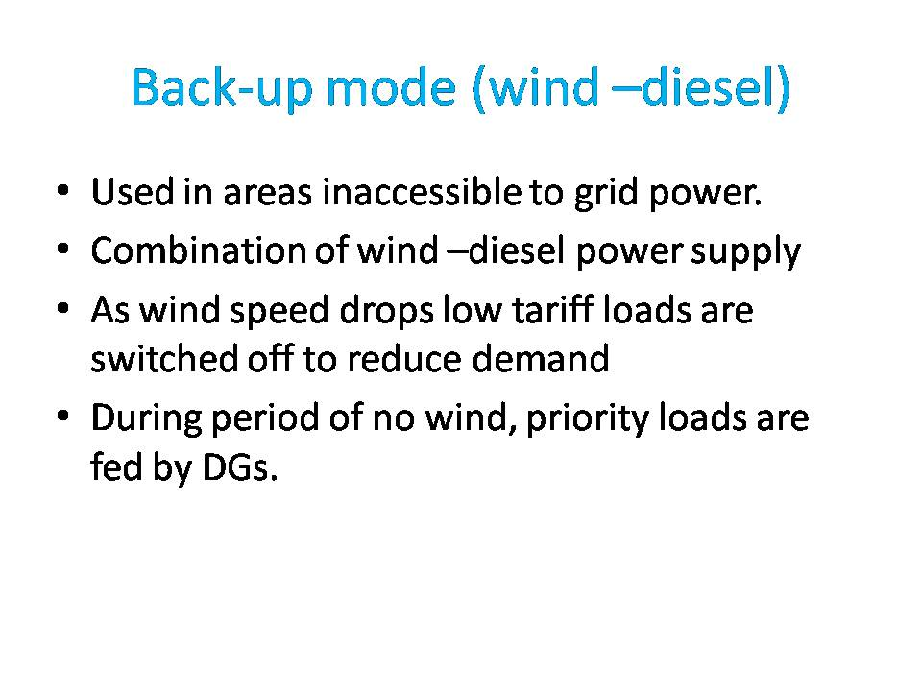

Slide 142
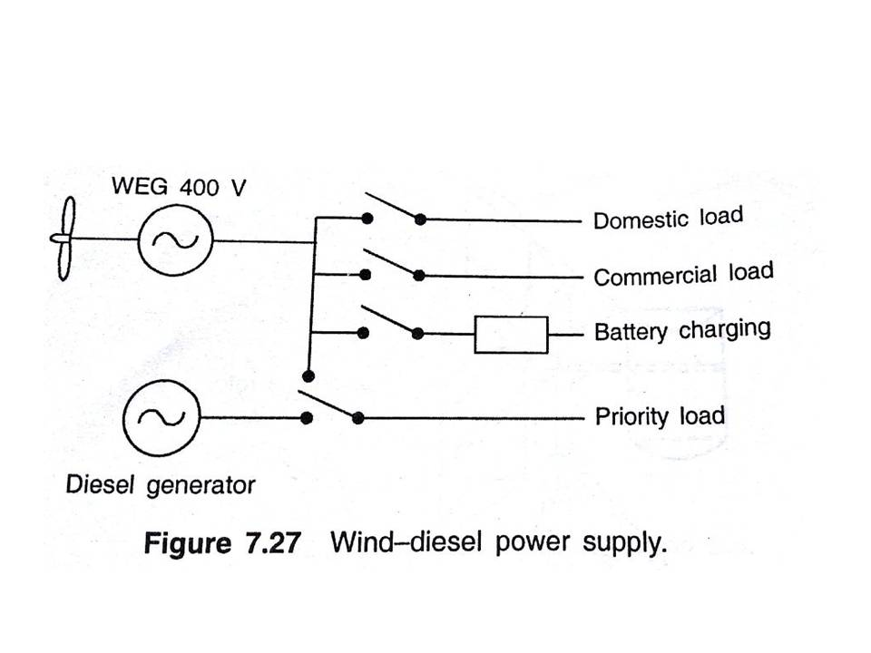

Slide 143
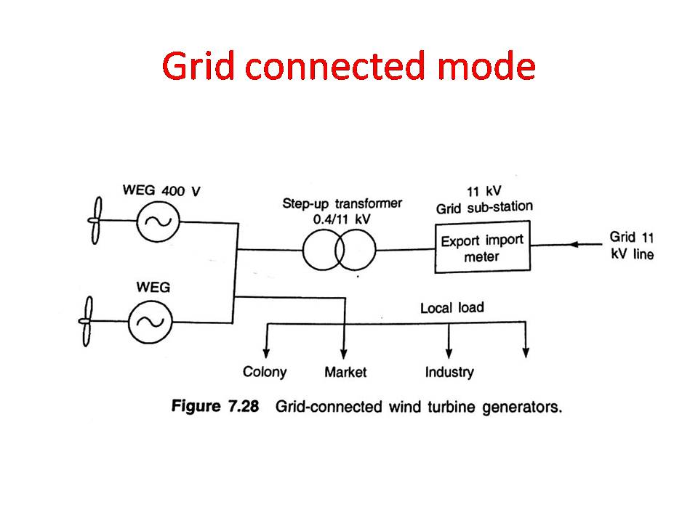

Slide 144
Advantages of wind energy
It is a renewable source of energy
Non polluting-so it has no adverse influence on the environment
Wind energy systems avoid fuel provision and transport
On a small scale up to a few kilowatt system is less costly On a large-scale costs can be competitive with conventional electricity and lower costs could be achieved by mass production

Slide 145
DISADVANTAGES OF WIND ENERGY
Wind energy is fluctuating in nature
Unlike water energy wind energy needs storage capacity because of its irregularity.
Wind energy systems are noisy in operation ; a large unit can be heard many kilometres away.
Wind power systems have a relatively high overall weight because they involve the construction of a high tower and include a gearbox, a hub and pitch changer, a generator coupling shaft etc.
Large areas are needed, typically, propellers 1 to 3m in diameter, deliver power in the 30 to 300 W range.
Present systems are neither maintenance free not-practically reliable.

Slide 146
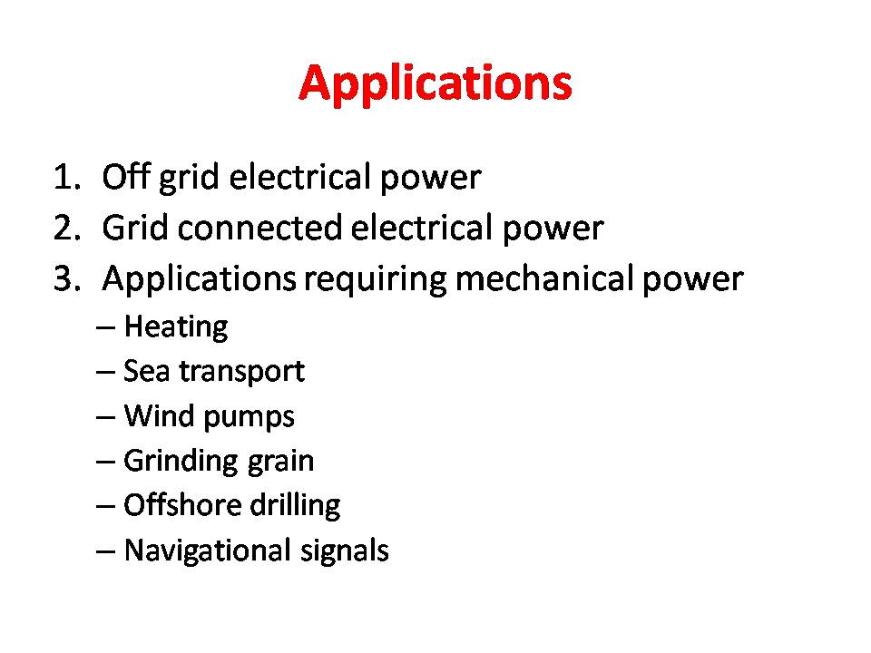

Slide 147
BASIC PRINCIPLES OF WIND ENERGY CONVERSION(***very imp)
The Nature of the Wind
The circulation of air in the atmosphere is caused by the non- uniform heating of the earth’s surface by the sun.
Nature of terrain, the degree of cloud cover and the angle of the sun in the sky are all factors which influences this process.

Slide 148
Average wind speeds are greater in hilly and coastal areas than they are well in land. ie winds also tend to blow more consistently and with greater strength over the surface of the water where there is a less surface drag.
Wind speeds increase with height. They have traditionally been measured at a standard height of ten metres(20-30% greater),for 60m (30-60% greater)

Slide 149
The power in the Wind
Wind possesses energy by virtue of its motion
Three factors determine the output from a wind energy converter :
the wind speed
the cross-section of wind swept by rotor
the overall conversion efficiency of the rotor, transmission system and generator or pump

Slide 150
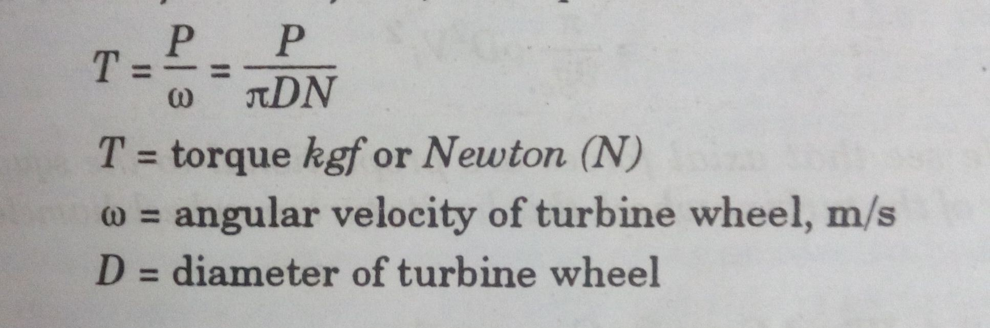

Slide 151
Capacity Factor
The capacity factor is the average power generated, divided by the rated peak power. Let’s take a five-megawatt wind turbine. If it produces power at an average of two megawatts, then its capacity factor is 40% (2÷5 = 0.40, i.e. 40%).

Slide 152
EFFECTS OF WIND SPEED AND GRID CONDITION

Slide 153
Wind generation impacts on the power quality
Wind energy is an intermittent source of power.
If a large proportion of the grid load is supplied by wind turbines, the output variations due to wind speed changes can cause voltage variation, flicker effects in normal operation.
The location and intermittent nature of wind turbine machines can cause power quality problems such as voltage stationary variations (drops, interruptions and rises of voltage (voltage dips)), voltage temporary variations (flicker), harmonics, frequency variations, and low power factor.
Wind turbines, especially inductive machines, tend to absorb reactive power from the system and produce a low power factor. If wind turbines absorb too much reactive power, the system can become unstable

Slide 154
Frequency variations are produced when differences in the power balance between generation and demand exist.
Wind speed variations, connection and disconnection of wind turbines cause differences in the generation; such differences can, in turn, cause frequency variations depending on the power system

Slide 155
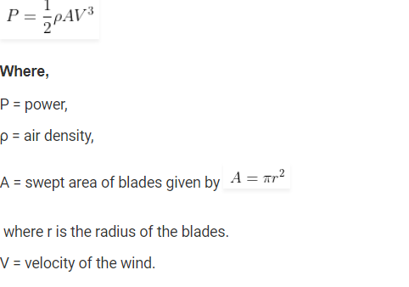
Wind Power Equation

Slide 156


Slide 157


Slide 158


Slide 159


Slide 160
29/12/25
3,4,5,7,14,19,25,40,51,57,61,64,69,72

Slide 161


Slide 162


Slide 163
V=25km/hr= 25x1000/3600=6.94m/s
Q= 5.1 m3/hr= 5.1/3600= 1.417x10-3 m3/s
H=9 m
𝜌w=996kg/m3
Poutput pump= 𝜌gQH
=996*9.81*1.417x10-3x9
=124.58W

Slide 164


Slide 165


Slide 166
SITE SELECTION CONSIDERATIONS
Wind energy conversion machines should be located preferable in areas where the winds are strong and persistent

Slide 167
High annual average wind speed
The wind velocity is the critical parameter
PW = KV³
Availability of anemometry data
The principal object is to measure the wind speed which basically determines the WECS output power
The anemometry data should be avail­able over some time period at the precise spot where any proposed WECS is to be built

Slide 168
Altitude of the proposed site.
It affects the air density and thus the power in the wind and hence the useful WECS electric power output
The winds tend to have higher velocities at high altitudes.

Slide 169
Terrain and its aerodynamic
It may be possible to make use of hills or mountains which channel the prevailing winds into a pass region, thereby obtaining higher wind power
Local Ecology
If the surface is bare rock - lower hub heights hence lower structure cost.
If trees or grass or vegetation are present, then higher hub heights - larger system costs than the bare ground case

Slide 170
Distance to Roads or Railways
For heavy machinery, structures, materials, blades and other apparatus will have to be moved into any chosen WECS site
Nearness of site to local centre/users
minimizes transmission line length and hence losses and costs
Nature of ground
foundations for a WECS are secured.
Ground surface should be stable & free from erosion
Favourable land cost.
Land cost should be favourable

